Slide 1
St. Vincent’s Primary
Curriculum Evening
Primary 1

Slide 2
Life at School
Encourage independence when possible – good problem solving
Lunch menu – Please try to let them know each day.
Label everything
Try to give your child a healthy snack

Slide 3
Life at School
Keep what your child is carrying to school to a minimum.
Our gyms days are Monday & Friday. Please always remember gym kits. (polo shirt and shorts)
Show & Tell (Theme for the week will be posted on Twitter page)

Slide 4
Homework
On Room 1 website page
Placemats – Literacy, Numeracy, Health & Well Being
Placemats should last 4/6 weeks (We will let you know)
Education City (logins will be given out soon)

Slide 5
Homework after September weekend
Tasks from placemats:
Sounds (2 sounds each week)
Common words (3 words each week)
1 Health and Wellbeing Task
1 Numeracy Task

Slide 6
Health & Well Being Placemat until September weekend
Try to choose 1 activity per week to focus on and feel free to tick them off as you go.
Get myself dressed every morning. | Eat at least 1 piece of fruit every day. | Wash my hands with soap after going to the toilet. | In school remember to put my name on the correct lunch mat.
Do something active every day. | Drink water every day. | Tidy my room. | Help someone.

Slide 7
Maths Homework Placemat until September Weekend
Sort the cutlery at home into different sets. | Match up pairs of socks. | Find 5 objects at home which are circles. | Can you find? 1 toothbrush 2 spoons 3 pegs 4 socks 5 books
Find a pattern in your house, e.g wallpaper, bricks etc. | Make a pattern using forks and spoons. | Find 5 objects at home which are square. | Find numbers in your house.

Slide 8
Literacy Homework Placemat until
September - October
Have lots of fun clapping out the syllables in words. Challenge: What’s the longest word you can find and how many claps does it have? | Practise writing your full name using Rainbow writing. A different colour for each phoneme. E.g. Charlotte | Find a cosy place and snuggle up with an adult. Ask them to read you a story that you have never heard before.
Learn a new rhyme and remember to tell your teacher about it so you can present it to your friends in class. | Go to your local library (join if you have not already) and have fun picking some books to borrow. | Find some bubble wrap and have fun bursting it but remember only to use your pointing finger and your thumb. This will help them get stronger to help your write beautifully!
Mums and Dads: Ask your child to dictate a story to you. It could be about special outings or activities. You write down whatever they say and encourage them to draw a picture of their story. | Multisensory Activity: Spread a little shaving foam on a table. Using your pointing finger practise writing curly ‘c’ letters: a, c, d, o. These letters that all start the same way. Remember don’t use too much foam! | Find three objects in your house that begin with the same phoneme as your name. Challenge: Find another 3 objects that begin with the same phoneme as your friends name.

Slide 9
Literacy
Phonics
2 sounds per week
LETTER NAME – like we say when we recite alphabet A,B,C…
LETTER SOUND – a,b,c (like we say when we are saying a word beginning with that letter)
Concentrate on the sound. “What words can you think of that begin with the sound…..”
Blending – word maker

Slide 10
Word Maker (1)
a
t
s
i
p
n
Can you make….?
at,sit,sat,pin,pan,nip,pit,sin,sip,tap,
tip,

Slide 11
Term 1 Mid Sept-Dec | Initial sounds | Common words |  | Term 2 Jan-March | Initial Sounds | Common Words |  | Term 3 April – June | Initial Blends |  | Common words
Week 1 2/9 | a t | a at the |  | Week 1 6/1 | y z | your by only |  | Week 1 20/4 | oo |  | had see has
Week 2 9/9 | s i | I in it |  | Week 2 13/1 | q(u) x | are dad not |  | Week 2 27/4 | ck |  | play no look
Week 3 16/9 | p n | an is and |  | Week 3 20/1 | Consolidation |  |  | Week 3 4/5 | ai |  | made, like, make
Week 5 30/9 | r m | am me my |  | Week 5 3/2 | sh (revise a, t, s i) | she come from |  | Week 5 11/5 | Consolidation
Week 6 7/10 | d e | did as he |  | Week 6 10/2 | ch (revise d, e, c, k) |  | with us so | Week 6 18/5 | oa | Said big could
Week 7 21/10 | c k ck | can we into |  | Week 7 18/2 | th |  | much of or | Week 7 25/5 | ie |  | Our down off
Week 8 28/10 | consolidation |  |  | Week 8 24/2 | Consolidation | Consolidation |  | Week 8 1/6 | ue |  | Him all came
Week 9 4/11 | g l | go got get |  | Week 9 2/3 | ng (revise g, l, f, o) | old do going |  | Week 9 8/6 | oy |  | here her before
Week 10 11/11 | f o | if for on |  | Week 10 9/3 | wh (revise b, u, h, w, j) |  | out now new | Week 10 15/6 | ph
Week 11 18/11 | b u | be but you |  | Week 11 16/3 | ee | one first little |  | Week 11 22/6 | Consolidation/Assessment
Week 12 25/11 | Consolidation |  |  | Week 12 23/3 | Consolidation
Week 13 2/12 | h w |  | was went his
Week 14 9/12 | j v |  | have just to
Week 15 16/12 | consolidation
October – Christmas Phonological Awareness Levels 5 & 6 |  |  |  | January – Easter Phonological Awareness Levels 7 & 8 |  |  |  | Easter – June Phonological Awareness Level 9
Evaluation |  |  |  | Evaluation |  |  |  | Evaluation

Slide 12
Literacy
Help your child to recognise the sounds and common words they have learned out in the world for example, shop names, books, newspapers etc.

Slide 13
Literacy
Reading
Look at the front cover. What can you see?
What could this story be about?
Point out turning the pages one at a time.
Point out you are reading the words from left to right.
Point to capital letter at the beginning and full stop at the ending making a HEALTHY SENTENCE.
Talk about characters and setting in reading books and other books. Ask questions e.g. What is happening in the story? What do you think would happen if?....

Slide 14
Literacy
Expose them to different types of text e.g. books, join the library, magazines, First News (newspaper for children), Non-Fiction etc.

Slide 15
Maths
August- October
Data Analysis (charts, menu, daily timetable)
Sorting and Matching
Numbers to 0 - 10 (Count, write, make, order, ordinal)
Shape (2D & 3D)
Pattern
Addition to 5 (language, counting on)
Time

Slide 16
Maths
Encourage children to use maths everyday with simple questions and answers.
Point out shapes to your children around the home.
Ask children to count the plates for dinner.
Let your child help you match up socks.

Slide 17
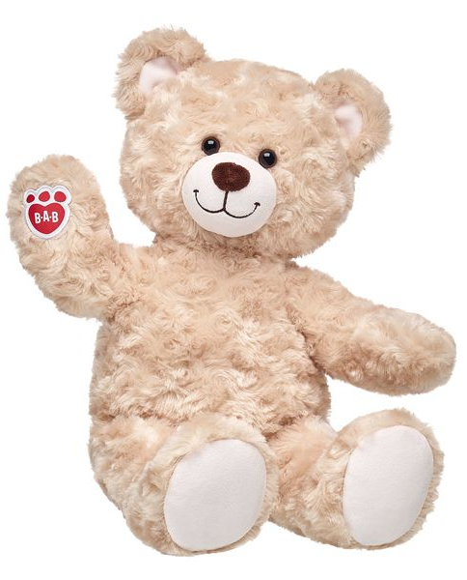
Adventure Ted
He will come home every week, on a Monday and returned on a Friday, with his suitcase and diary.
Children are encouraged to take care of him and his belongings e.g. brush his hair.
Take pictures with your child and Adventure Ted together. It doesn’t need to be exotic or exciting, it can be something simple like sitting at the dinner table, reading a book etc
Encourage your child to tell you what they have done with Adventure Ted, in their own words, as you write in his diary and include pictures.
Help your child to pack Adventure Ted’s suitcase at the end of his stay by checking off his list of belongings.

Slide 18
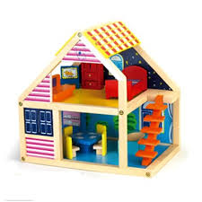
Play
Encouraging the children to take responsibility for their learning.
A mixture of free play and structured play.
Promotes independence and choice with the children.
Children are more motivated in their learning because they are actively involved in the decision making.
Children are able to choose where and how they work e.g. standing etc.
They are leading their learning and we are able to focus on their own interests rather it being prescriptive.

Slide 19
Communication
Our class twitter page will be updated regularly with pictures of the children working and playing. Important information and reminders will be posted regularly.
Follow us @Room1StVs.
The school App is used to communicate whole school information. Please ask for login details tonight.
The school website is also available although the class twitter will be used more frequently.
http://www.st-vincents-pri.s-lanark.sch.uk/index.htm

Slide 20
Useful Websites
www.doorwayonline.org.uk
www.spellingcity.com
www.topmarks.co.uk
www.bbc.co.uk/schools/ks1bitesize
www.educationcity.co.uk
www.magickeys.com/books/
www.abcteach.com

